Slide 1
Fourier Integral
Nazmul Kader Chowdhury

Slide 2

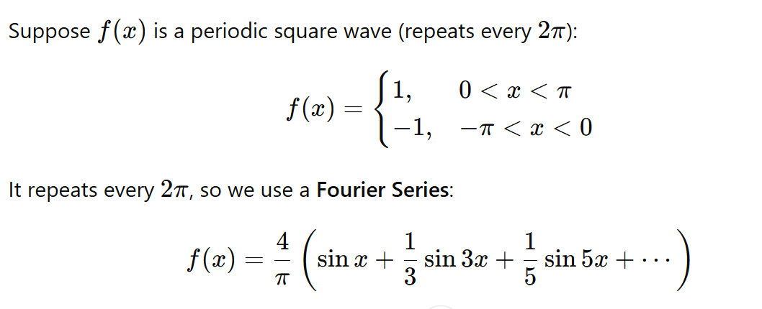

Slide 3


Slide 4


Fourier Integral :

Slide 5

USEFUL FORMULA

Slide 6


PROBLEMS

